Slide 1
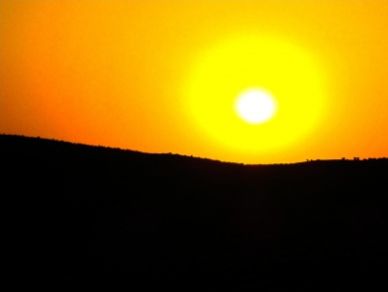
Volcanoes

Slide 2
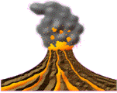
Volcanoes are openings in the Earth’s surface. When they are active they can let ash, gas and hot magma escape in sometimes violent and spectacular eruptions

Slide 3
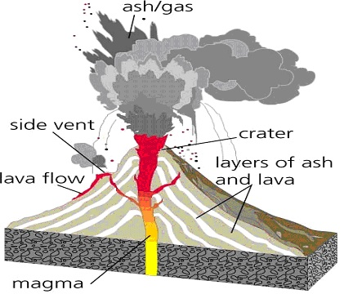

Slide 4
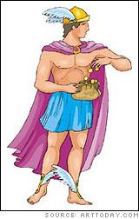
The word Volcano originally comes from the name of the Roman god of fire, Vulcan.

Slide 5
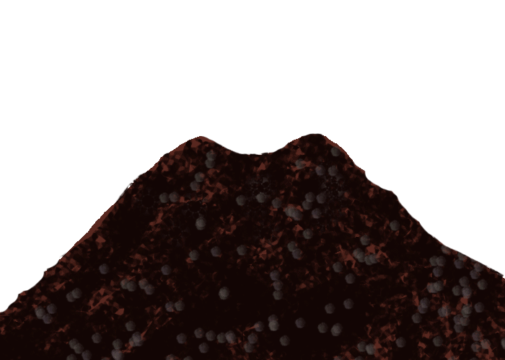
Volcanoes are usually located where tectonic plates meet. This is true for the Pacific Ring of Fire, and area around the Pacific Ocean where over 75% of the volcanoes on Earth are founds.

Slide 6
While most volcanoes form near tectonic boundaries, they can also form in areas that contain abnormally hot rock inside the Earth. Known as mantle plumes, these hotspots are found at a number of location around the globe, with the most notable being in Hawaii..

Slide 7
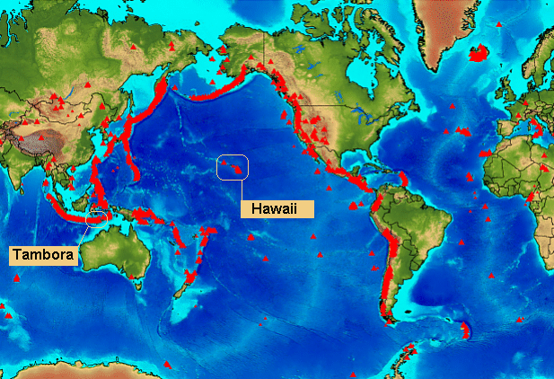

Slide 8
Hot liquid rock under the Earth’s surface is known as magma, it is called lava after it comes out of the volcano. Click on the link below to check out a video of lava burning a rock
http://www.youtube.com/watch?feature=player_embedded&v=KGmLMbw_1CE

Slide 9
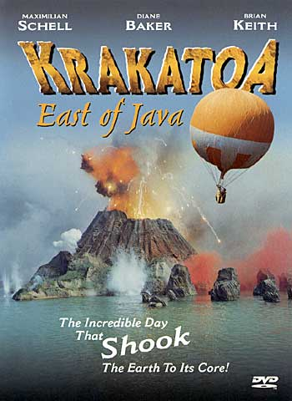
Some famous volcanic eruptions of modern times include Mount Krakatoa in 1883, Novarupta in 1912, Mount St Helens in 1980 and Mount Pinatubo in 1991.

Slide 10
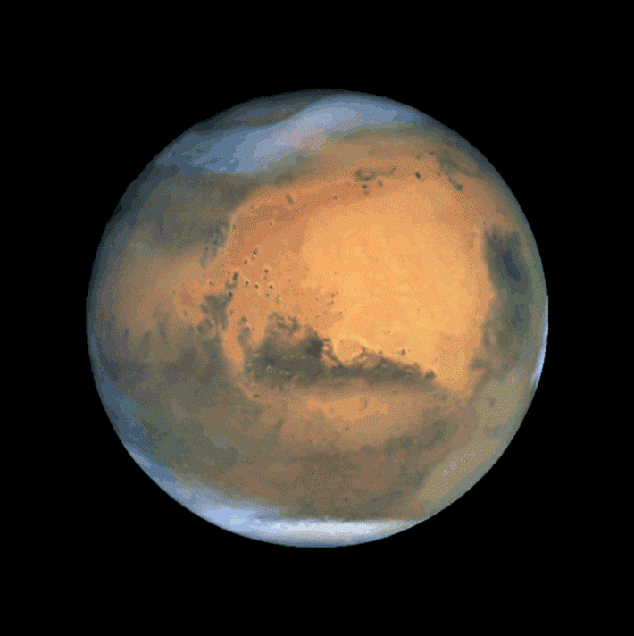
While we certainly have some big volcanoes here on Earth, the biggest known volcano in our solar system is actually on Mars. Its name is Olympus Mons and it measures a whopping 600km wide and 21km high!

Slide 11
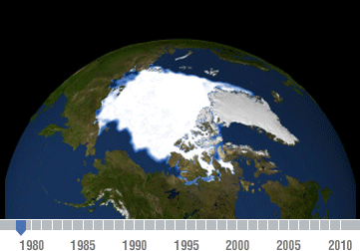
There are also volcanoes found on the ocean floor and even under icecaps such as those found in Iceland

Slide 12

Volcanoes can be active (regular activity) dormant (recent historical activity but now quiet) or extinct (no activity in historical times and unlikely to erupt again).

Slide 13
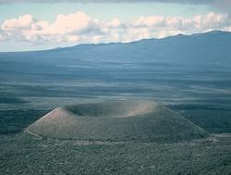
Explosive eruptions can throw lava and rock high into the air. These bits of rock and solidified magma are called tephra. When the tephra falls it forms a steep sided volcano called a cinder cone volcano. A good example of this type of volcano is the Parictutin in Mexico.

